Slide 1
Module 9
File and Storage Services in Windows Server 2016
Notes:
Presentation: 50 minutes
Lab: 40 minutes
After completing this module, students will be able to:
Manage disks in Windows Server 2016.
Manage volumes in Windows Server 2016.
Required materials
To teach this module, you need the Microsoft PowerPoint file 20740C_02.pptx.
Preparation tasks
To prepare for this module:
Read all of the materials for this module.
Practice performing the demonstrations and labs.
Work through the Module Review and Takeaways section to determine how you will use the information to reinforce student learning and promote knowledge transfer to on-the-job performance.
As you prepare for this class, it is imperative that you complete the labs yourself. This gives you an understanding of how the labs work, in addition to the concepts that each lab covers. This enables you to provide meaningful hints to students who might have issues while working in the labs. Furthermore, it will help guide your lecture to ensure that you discuss the concepts that the labs cover.
20740C
2: Configuring local storage

Slide 2
Module Overview
Managing disks in Windows Server Managing volumes in Windows Server
Notes:
Briefly describe the lessons in this module.
20740C
2: Configuring local storage

Slide 3
Lesson 1: Managing disks in Windows Server
Selecting a partition table format Selecting a disk type Selecting a file system Implementing ReFS Demonstration: Configuring ReFS Using .vhd and .vhdx file types Selecting a disk type
Notes:
Briefly describe the topics included in this lesson.
Question
What disk types are you most commonly using in your organization, and do you have a management and provisioning strategy for storage usage in particular scenarios?
Answer
Answers will vary based on student experiences.
Question
ReFS supports data deduplication in Windows Server 2016.
( ) False
( ) True
Answer
(√) False
( ) True
20740C
2: Configuring local storage

Slide 4
Selecting a partition table format
MBR
Standard partition table format since the early 1980s
Supports a maximum of four primary partitions per drive
Can partition a disk up to 2 TB
GPT
GPT is the successor of the MBR partition table format
Supports a maximum of 128 partitions per drive
Can partition a disk up to 18 exabytes
Use MBR for disks smaller than 2 TB
Use GPT for disks larger than 2 TB
Notes:
Provide an overview of the two partition table formats that are available in the Windows operating system:
Master boot record (MBR)
Globally unique identifier (GUID) partition table (GPT)
Mention that MBR has been around for more than 30 years and that GPT is the enhanced version of MBR that addresses larger disks.
20740C
2: Configuring local storage

Slide 5
Selecting a disk type
Basic disks are:
Initialized for basic storage
The default storage for the Windows operating system
Dynamic disks can:
Be modified without restarting the Windows system
Provide several options for configuring volumes
Disk volume requirements include:
A system volume for hardware-specific files that are required to start the server
A boot volume for the Windows operating system files
Notes:
Provide an overview of a basic disk and a dynamic disk.
20740C
2: Configuring local storage

Slide 6
Selecting a file system
When selecting a file system, consider the differences between FAT, NTFS, and ReFS
FAT provides:
Basic file system
Partition size limitations
FAT32 to enable larger disks
exFAT developed for flash drives
NTFS provides:
Metadata
Auditing and journaling
Security (ACLs and encryption)
ReFS provides:
Backward compatibility support for NTFS
Enhanced data verification and error correction
Support for larger files, directories, and volumes
Notes:
Provide an overview of the available file systems in Windows operating systems: file allocation table (FAT), NTFS file system, and Resilient File System (ReFS). In particular, be sure to explain that Windows Server 2012 introduced ReFS to ensure that error verification and correction was still possible on very large volumes.
Discuss when you would use which file system, but stress that ReFS currently is the best solution for servers. This is because it provides better error checking, better reliability, and less corruption.
Question
What file system do you currently use on your file server and will you continue to use it?
Answer
Answers could vary. A common answer is NTFS, because NTFS should be the basis for any file system used on a Windows Server operating system. If you use FAT32 or Extended FAT (exFAT), you should be able to support your decision, because these file systems do not support security access control lists (ACLs) on files and folders.
The second part of the question focuses on switching to ReFS when upgrading to Windows Server 2016. You might answer yes because it is more reliable, or you might answer no, because you want to wait until it is used more widely in the market.
20740C
2: Configuring local storage

Slide 7
Implementing ReFS
ReFS has a number of advantages over NTFS:
Metadata integrity with checksums
Expanded protection against data corruption
Maximizes reliability
Large volume, file, and directory sizes
Storage pooling and virtualization
Redundancy for fault tolerance
Disk scrubbing for protection against latent disk errors
Resiliency to corruptions
Shared storage pools across machines
Notes:
Explain ReFS. Start with the reasons why Microsoft implemented this file system. Mention that the requirements for larger volumes increase due to the current trend in virtualization technologies.
Discuss the issues that prevent NTFS file systems from managing very large volumes when the file system does not provide sufficient error-tracking and self-repairing mechanisms, especially for multi-terabyte (TB) volumes.
20740C
2: Configuring local storage

Slide 8
Using .vhd and .vhdx file types
Virtual hard disks are files that you can use the same way as physical hard disks
You can:
Create and manage virtual hard disks by using Disk Management and Diskpart.exe
Configure .vhd or .vhdx files
Configure computers to start from the virtual hard disk
Transfer virtual hard disks from Hyper-V servers, and start computers from the virtual hard disk
Use virtual hard disks as a deployment technology
Notes:
Ask students if they have worked with virtual hard disks in Microsoft Hyper-V. If students have used virtual hard disks in this context, ask them what they use the disks for in Hyper-V.
Students should be aware that the virtual machines in Hyper-V use virtual hard disk files to run the operating system and to store data. Point out that they can use the same virtual hard disk files outside of Hyper-V by using the native virtual hard disk boot feature.
Consider demonstrating the following cmdlets to students by starting your computer to LON-HOST1. You can, if you prefer, run the last exercise in the lab.
Get‑Partition. Run the Get‑Partition cmdlet to list all disks and their associated partition numbers.
Get‑Disk. Use the Get‑Disk cmdlet to obtain detailed disk information about a disk. Use the partition number of a disk that is shown in the output of Get‑Partition. For example, if you want to obtain information on partition number 0, then you can run the following command:
Get‑Disk ‑Number 0 | FL
Get‑Volume. Run the Get‑Volume cmdlet to obtain a list of volumes, their labels, the file systems in use, the drive types, the health status, the space remaining, and the total size of each volume.
Piping
If students show interest, you can demonstrate simple piping by running the following command:
Get‑Partition | Get‑Disk | FL
Then, show how to filter output. This is useful on a system that contains many volumes. For example, to list all of the volumes that only have the ReFS file system and display their drive letters and the file system types, you can run the following command:
Get‑Volume | Where {$_.FileSystem ‑eq “ReFS”} | FL DriveLetter,FileSystem
20740C
2: Configuring local storage

Slide 9

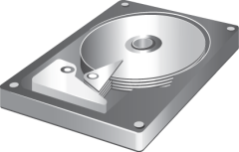
Selecting a disk type
As performance increases, so does cost
SSD
SAS
Performance
SCSI
Slow Slow ~ 150 IOPS ~210 IOPS Fast: 1.5mio IOPS
SATA
EIDE
Cost
Notes:
Provide an overview of the types of disks that are available options for storage. Mention that in servers, you typically find serial attached SCSI (SAS) disks because they are the most reliable. Serial Advanced Technology Attachment (SATA) disks are cheap and provide mass storage, but they are not built for 24 hours a day, seven days a week (24/7) server operations. Finally, discuss the role of solid-state drives (SSDs), which are capable of providing extremely fast performance, but also are extremely expensive.
Ask students what types of storage their companies use and why they think that type was chosen.
20740C
2: Configuring local storage

Slide 10
Lesson 2: Managing volumes in Windows Server
What are disk volumes? Options for managing volumes Demonstration: Managing volumes Extending and shrinking a volume What is RAID? RAID levels
Notes:
Briefly describe the topics in this lesson.
Question
Should you configure all disks with the same amount of fault tolerance?
Answer
No, not all disks need the same tolerance. A common practice is to use RAID 1 for the operating system volume and RAID 5 for the data volumes.
20740C
2: Configuring local storage

Slide 11
What are disk volumes?
Windows Server 2016 supports the following volume types:
Simple
Spanned
Striped
Mirrored
RAID-5
Notes:
Describe the volume types and explain when you might use each type. The demonstration at the end of the lesson shows students how to create and manage volumes.
20740C
2: Configuring local storage

Slide 12
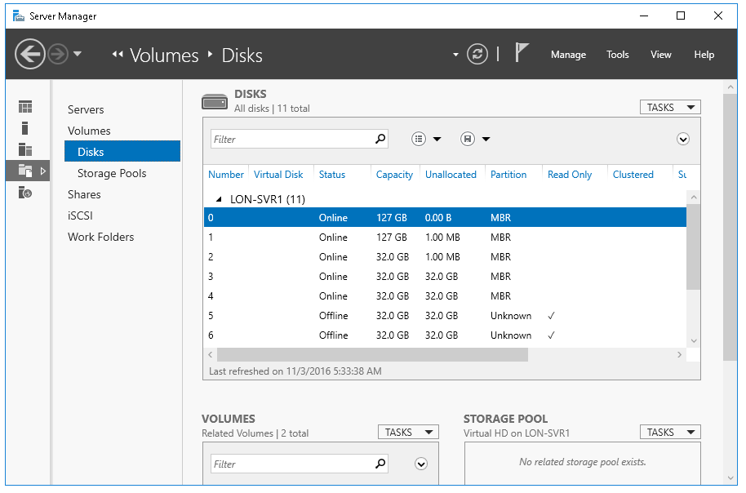
Options for managing volumes
Notes:
This topic has three additional slides, each with a screenshot of one of the tools that you use for managing volumes in Windows Server 2016. Consider performing the demonstration in the next topic as you discuss this content.
Describe how to use Server Manager to add and configure disk volumes.
20740C
2: Configuring local storage

Slide 13
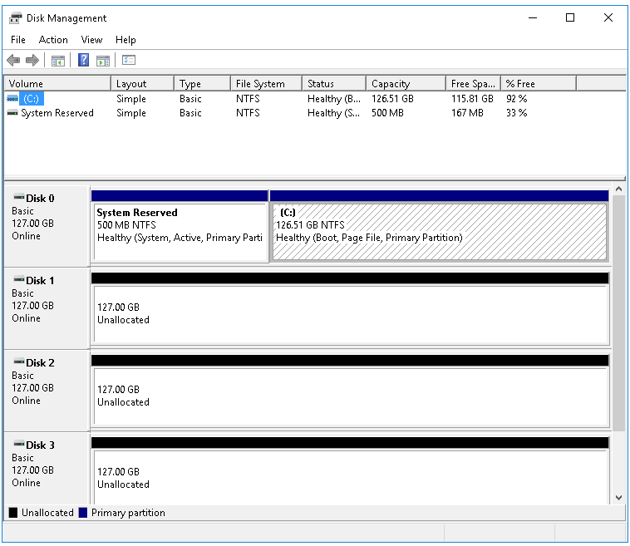
Options for managing volumes
Notes:
Use the subsequent demonstration to show how to create volumes with Disk Management.
20740C
2: Configuring local storage

Slide 14
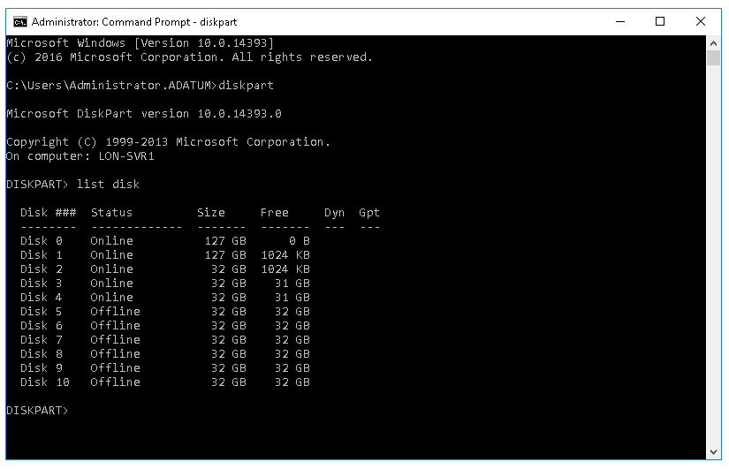
Options for managing volumes
Notes:
Use the subsequent demonstration to show how to create volumes with Diskpart.exe.
20740C
2: Configuring local storage

Slide 15
Options for managing volumes
Get-disk
Clear-disk
Initialize-disk
Get-volume
Format-volume
Notes:
Use the subsequent demonstration to show how to create volumes with Windows PowerShell.
20740C
2: Configuring local storage

Slide 16
Extending and shrinking a volume
You can resize volumes with Windows Server 2016
When you want to resize a disk, consider the following:
You can extend or shrink NTFS volumes
You can only extend ReFS volumes
You cannot resize FAT, FAT32, and exFAT volumes
You can shrink a volume only up to immovable files
You cannot shrink a volume with bad clusters
Notes:
In this topic, explain how to resize volumes. Start with a short discussion about when you would need to resize a volume. For example, you might want to extend a disk if a volume runs out of disk space. Mention that another way to make file space available in your system is to create mount points to other volumes. Also, mention that you can extend ReFS volumes only: you cannot shrink them.
20740C
2: Configuring local storage

Slide 17
Lab: Configuring local storage
Exercise 1: Creating and managing volumes Exercise 2: Resizing volumes Exercise 3: Managing virtual hard disks
Logon Information
Virtual machines: 20740C-LON-DC1
20740C-LON-SVR1
20740C-LON-HOST1
User name: Adatum\Administrator
Password: Pa55w.rd
Estimated Time: 40 minutes
Notes:
Before the students begin the lab, read the lab scenario and display the next slide. Before each exercise, read the scenario associated with the exercise to the class. The scenarios give context to the lab and exercises and help to facilitate the discussion at the end of the lab. Remind the students to complete the discussion questions after the last lab exercise.
Exercise 1: Creating and managing volumes
In the test lab, you start by creating a number of volumes on the installed hard disks.
Instructor Note: Be available to help students with the syntax of the Windows PowerShell cmdlets.
Exercise 2: Resizing volumes
You create a new volume, and then realize that you must resize it. You decide to use Diskpart.exe to complete this process.
Exercise 3: Managing virtual hard disks
You are required to create and configure virtual hard disks for use in a Windows Server 2016 server computer. The virtual hard disk is for the Sales department. You decide to use Windows PowerShell to achieve these objectives. First, you must install the Windows PowerShell Hyper-V module.
Instructor Note: Your students must restart their computers and select 20740C-LON-HOST1. Be prepared to help them with this process.
20740C
2: Configuring local storage

